Slide 1
Today is 3.14.16: the most accurate National Pi Day ever
314.159 nm
|---- 100 nm ----|
Doye et al, Phys Chem Chem Phys, 2013
Rothemund, Nature, March 16, 2006
Notes:
Today is 3 – 14 – 16, National Pi Day. This day celebrates the ratio of the diameter to the circumference of a three-hole disk. It is a happy day.
These three-hole disks are, of course, DNA origami, and today is also the penultimate day prior to the 10 year anniversary of the publication of Paul Rothemund’s paper that introduced the world to scaffolded DNA origami.

Slide 2

Ten Years of DNA Origami
Organizers: Ebbe Sloth Andersen, Shawn Douglas, Richard Murray, Niles Pierce, Lulu Qian, Ned Seeman, William Shih, Fritz Simmel, Erik Winfree
Coordinator: Lucinda Acosta
Credit: Paul Rothemund
|-100nm-|
------------------------------------ Sponsors ------------------------------------
Autodesk Research
Credit: Aaron Berliner
|- 80 nm -|
Rosen Bioengineering Center at Caltech
Credit: Sungwook Woo
|---- 300 nm ----|
The Information Science and Technology
initiative at Caltech
The Molecular Programming Project
(an NSF-funded Expedition in Computing)
Notes:
Hence this symposium. I would like to start by thanking the co-organizers, who provided help and guidance throughout the process of putting this thing together. I am Erik Winfree, and the co-organizers are Ebbe, Shawn, Richard, Niles, Lulu, Ned, William, and Fritz. Thank you all very much! The person who really made this happen was Lucinda, without whom we would be gathering under an oak tree and orating like Plato and Socrates. Happily, we have a room, nice chairs, a video projector, and much more – actually, it was a lot of work. Let’s thank Lucinda.
This is also my opportunity to thank the symposium sponsors, who have been very generous: First is Autodesk Research, who have been involved in the development of caDNAno, the first computer-aided design software for DNA origami, and who continue to push the frontiers of molecular modeling and design. Joseph Schaeffer, from Autodesk, is here in the audience, and I hope you’ll have a chance to talk with him. The Donna and Benjamin Rosen Bioengineering Center at Caltech is the second sponsor; they have done wonderful, wonderful things for bioengineering at Caltech, this symposium being a tiny blip on the radar. We are very grateful to them both. Our third sponsor is Caltech’s Information Science and Technology initiative, which aims to promote interdisciplinary research that applies the concepts and tools of the information age to better understand and engineer natural and artificial systems. Finally, the NSF-sponsored Molecular Programming Project – a collaboration between Caltech, the University of Washington, Harvard, and UCSF that aims to advance the science and technology of information-based molecular systems – is also helping out.

Slide 3
Helpful information:
No food or drink in the auditorium!
Wireless: Caltech Guest, eduroam
  Might need to disable OCSP
  https://imss.caltech.edu/content/caltech-guest-wireless-network
How many extra spots at banquet?
Notes:
I’d also like you to help out, too. Specifically, please help keep this lovely auditorium clean. Please note the signs that remind you that food and drink are not permitted in the auditorium. We didn’t hire anyone to look under the chairs for empty cups and discarded paper plates, so if you do see anything, please pick it up and throw it away in the trash cans outside the auditorium. Thanks much. Regarding wireless, you should be able to get online using either the Caltech Guest network, or eduroam if you’ve signed up for it. That concludes our public service announcement.
Now I’d like to get to the content. I imagine that most of the people here know what DNA origami is already, but those who don’t will get a gentle introduction in the next few slides. I am going to tell a “genesis story” about DNA origami. This is an unofficial version; Paul has neither seen nor approved what I’m going to say, so he might beg to differ or feel compelled to correct a few points that I get wrong. In any case, I will proceed by way of snapshots.

Slide 4
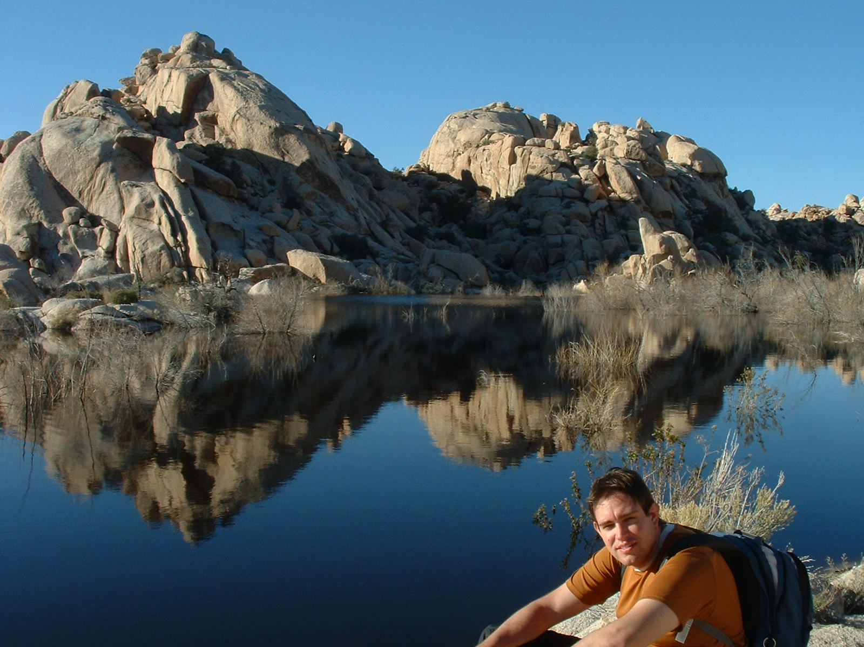
Notes:
DNA origami came out of Paul’s head, so I am going to start by talking about Paul. I like this photo of Paul, not only because it’s a beautiful mountain lake, but because it emphasizes Paul’s connection to nature. Nature knows no bounds, and neither does Paul’s curiosity and intellect. Chemistry, computer science, physics, biology, mathematics, geology – these are just different ways to appreciate nature, not boundaries to what one is willing to understand deeply. To Paul, at least. He is scientifically omnivorous.

Slide 5
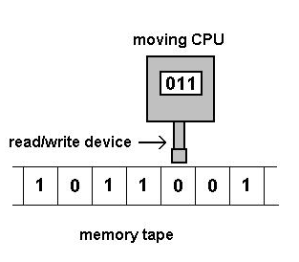
1993: Paul as a Caltech undergraduate
Computer Science / Biology dual major
CS/EE/Ma 129: Information and Complexity (Yaser Abu-Mostafa)
“A DNA and restriction enzyme implementation of Turing machines”
Paul W. K. Rothemund, DNA Based Computers, DIMACS, 1996
Notes:
So it should come as no surprise that as a Caltech undergraduate, Paul did research with a chemist, Bob Grubbs, and ended up with a dual major in computer science and biology. As far as I know, the first time I laid eyes on him was in a computer science class, which I was taking as a first-year graduate student. A part of the class was an independent research project of our own invention. I chose to study cellular automata. I distinctly remember the final presentations, when a gangly, awkward, and very tall kid started talking about how he was trying to design a Turing machine that encoded its state in a DNA molecule and modified its information using restriction enzymes. Who would have thought that was possible? I remember thinking, “This is the kind of research that I should be doing!” About a year later, Len Adleman’s seminal paper on DNA computers was published, and Paul was kicked into action to work out the final details and write it up.

Slide 6
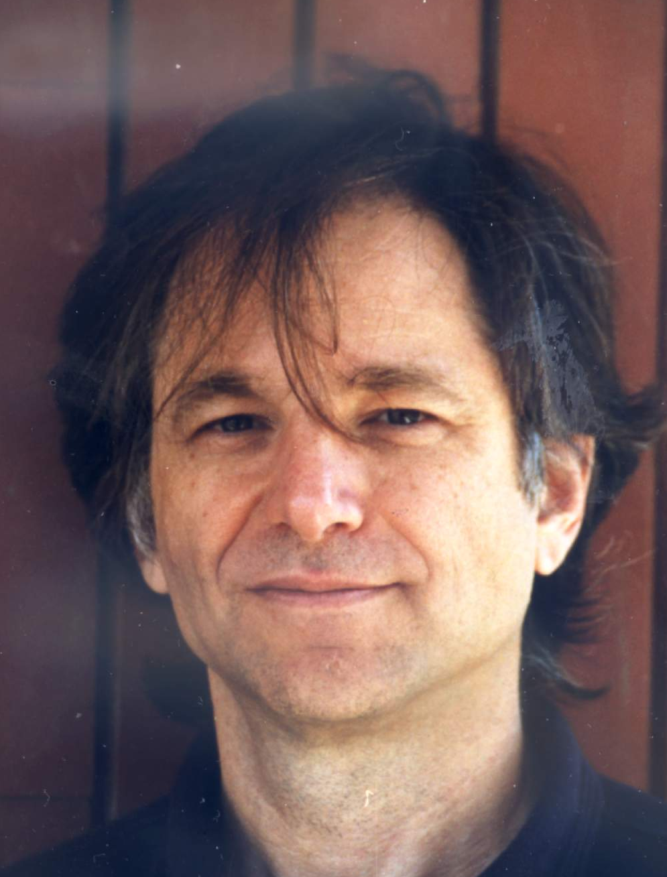
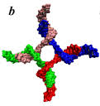
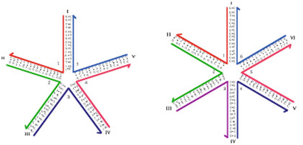
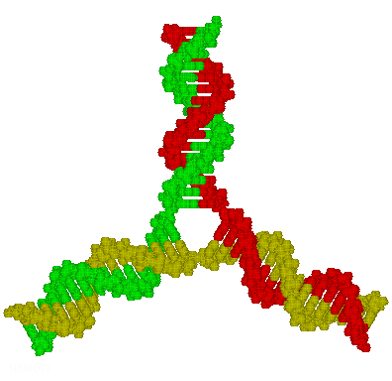
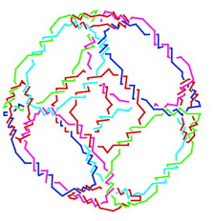
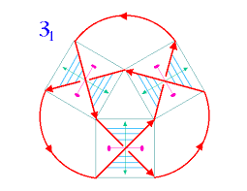
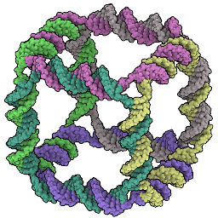
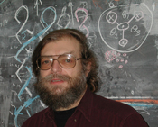
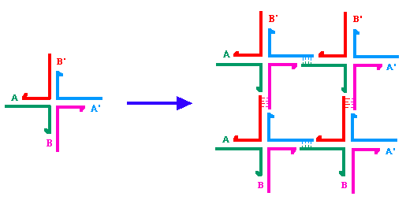

1995: encounter at the Red Door Cafe
“Molecular computation of solutions to combinatorial problems” Leonard M. Adleman, Science, 1994
Nadrian C. Seeman, all over the place, 1982-1995
Notes:
I guess Len Adleman’s paper launched both our careers. It also brought us together. The second time I saw Paul was when we met to compare notes on Len Adleman’s paper, and Paul told me about the most interesting research had had been reading about – especially the remarkable things that Ned Seeman was doing with DNA nanotechnology. I got a glimmer of how such things might be connected to mathematical tiling theory – eventually, the subject of my PhD thesis. So, thanks, Paul, for the introduction. In fact, only a few months after meeting at the Red Door Café, Paul and I found ourselves at the first meeting on DNA Based Computers in Princeton, presenting our ideas. That’s where we met both Len and Ned. Later that summer, I spent a month or so in Ned’s lab, learning experimental techniques, and eventually we had a wonderful paper together. Paul, on the other hand, ended up going to graduate school to join Len’s lab.

Slide 7
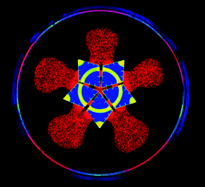
2000: Paul as a USC graduate student
“Solution of a 20-Variable 3-SAT Problem on a DNA Computer”
Braich, Chelyapov, Johnson, Rothemund, Adleman, Science, 2002
“Using lateral capillary forces to compute by self-assembly”
Paul W. K. Rothemund, PNAS, 2000
TNT
“The program-size complexity of self-assembled squares”
Paul W. K. Rothemund, Erik Winfree, STOC, 2000
“Theory and Experiments in Algorithmic Self-Assembly”
Paul W. K. Rothemund, PhD Thesis, 2001
Notes:
It was a truly unique situation. Len, known for theoretical work in algorithms, number theory, and cryptography, was setting up an experimental lab to push DNA computing to the limit. Apparently, they did reach the limit, eventually: 20 variables. But meanwhile Paul was the TA for Len’s class on mathematical logic. And he studied how to use hydrophobic paint and surface tension to program the self-assembly of centimeter-scale tiles floating on water. With me, he studied the theory of tile assembly and how it relates to Turing machines, and we published in a top theoretical computer science conference. Throughout these years, Len was a constant source of inspiration, hosting a weekly meeting that he liked to refer to as “TNT” – The Next Thing – because he was always pushing to discover the unexpected. Great times. Anyway, when Paul graduated, he came to my lab as a postdoc.

Slide 8
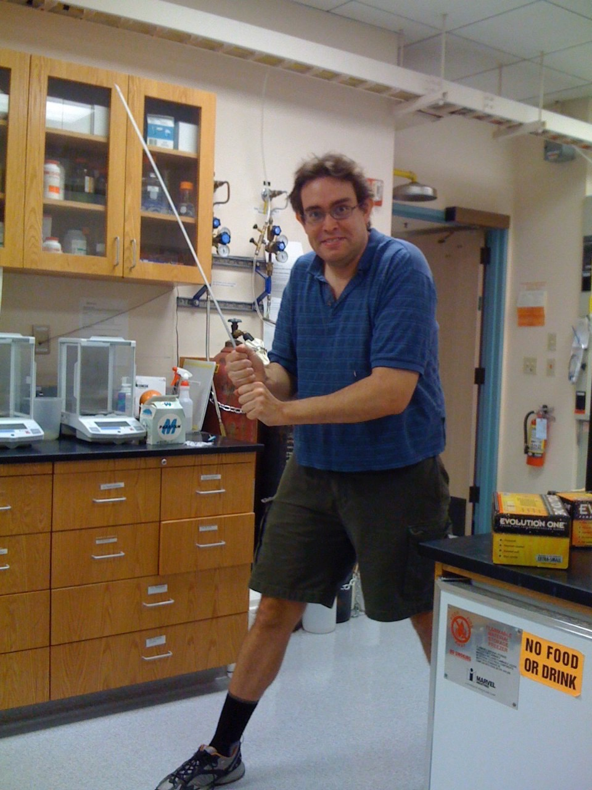
2004: Paul as a postdoc at Caltech
|-- 100 nm --|
Rothemund, Papadakis, Winfree, PloS Biology, 2004
Notes:
He was there pretty much from the beginning, helping set up my new lab. What instrument should I purchase? Do I need an autoclave? How do we order stuff? How do we get this student on track? No way I would have survived without his help. I really didn’t know what I was doing. Must have driven him crazy from time to time.
Nonetheless, we accomplished some great things. Including writing the paper that I am most proud of in my whole career. We made DNA tiles that self-assemble to grow a computationally-defined pattern, showing that algorithmic behavior is inherent in crystal growth processes.
I hope you enjoyed that brief history – but what has it got to do with DNA origami? The argument I am trying to make is that DNA origami is the kind of thing that happens when computer science and molecular science merge. Inventing scaffolded DNA origami, Paul used computational thinking to generalize a specific case of DNA nanostructure design to discover a general case; he focused on the information aspect. So let me now tell you about the invention itself – how did it happen? Well, I can’t tell you; I don’t know. Paul sort of disappeared from the lab at some point, but I hardly noticed, I was just trying to keep my head above water with so many other things going on.

Slide 9
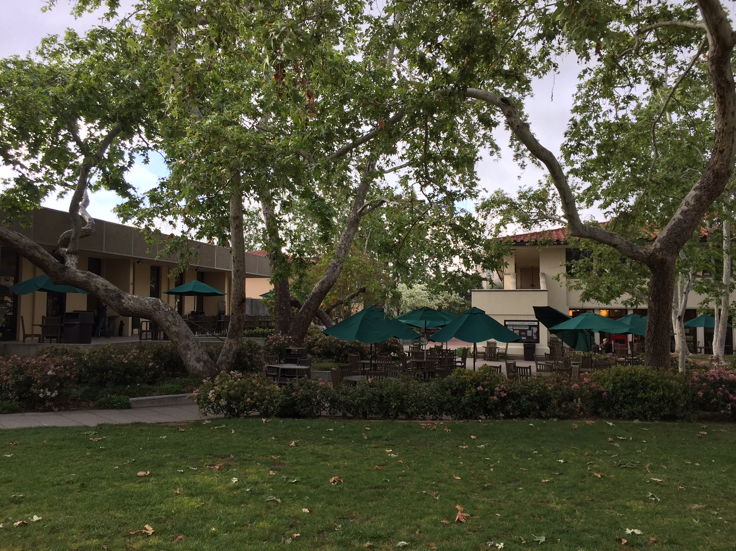
2005: encounter at the Red Door Cafe
Notes:
Then one day Paul reappeared, and told me that we needed to talk. Again, we went to the Red Door Café. Lovely spot – a lot happens there. Anyway, that’s where Paul told me that he’d been trying to take a single-stranded DNA virus genome and fold it into a rectangle, using short DNA strands to “staple” the right parts together. The reason that I hadn’t seen him much, he said, was that he was at home writing software to automatically design the DNA sequences that he needed. In fact, he has often said that the research for his first DNA origami paper consisted of 90% coding in Matlab, 1% performing the self-assembly experiment, and 10% fussing with the atomic force microscope to get good images. I think that’s the ideal stoichiometry. In any case, the first image he showed me was something like this – yes, it was a rectangle! But then he also showed me this – it was as stretchable as a loose wool sweater. More work to do.

Slide 10
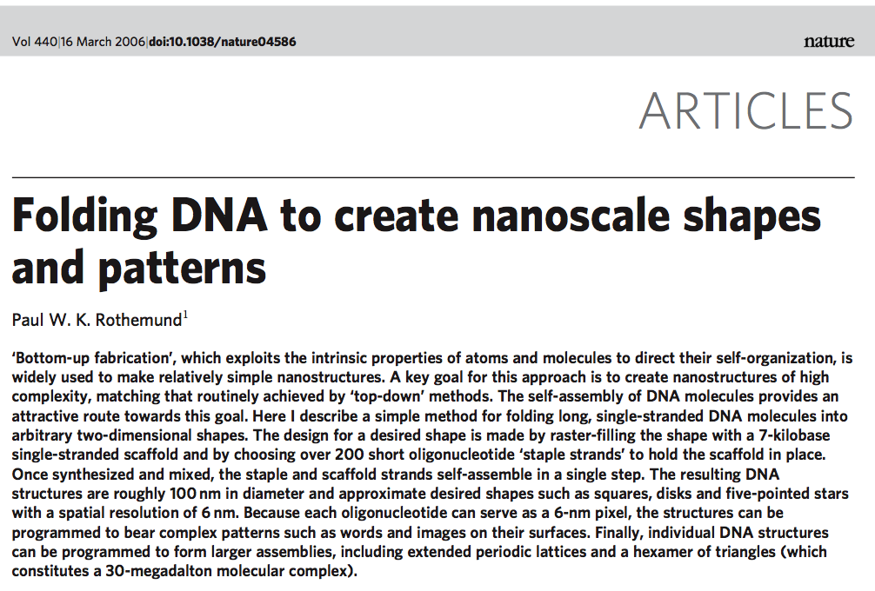
Scaffolded DNA origami
Notes:
After he was satisfied with the quality and generality of his approach, he published.

Slide 11
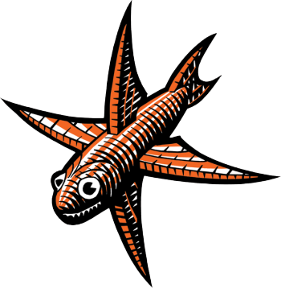
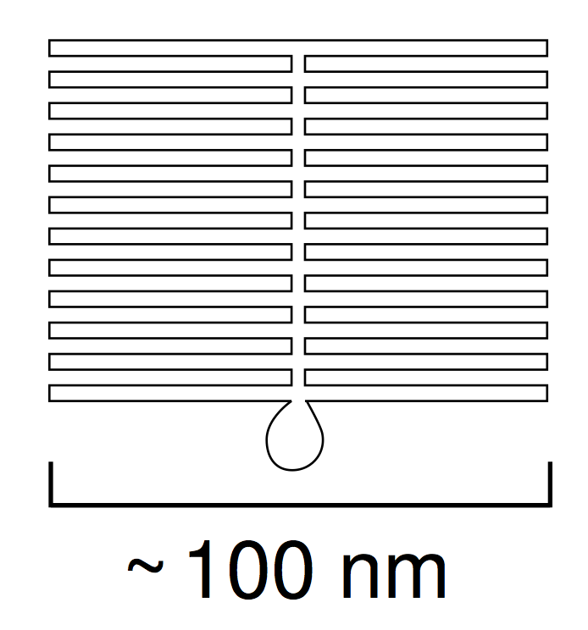
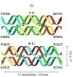
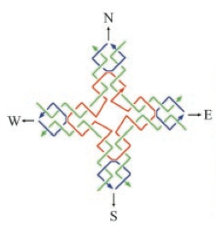
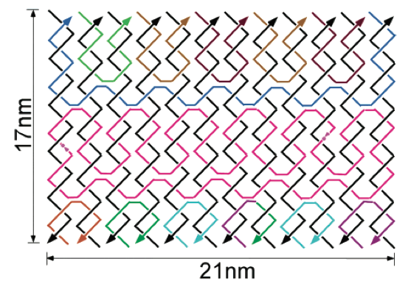
The path to scaffolded DNA origami
Seeman, J. theor. Biol. 1982
Kallenbach et al, Nature 1983
Fu et al, Biochemistry 1993
Yan et al, Science 2003
Yan et al, PNAS 2003
Shih et al, Nature 2004
Ke et al, JACS 2006
Rothemund, Nature 2006
Notes:
11
Although I’ve emphasized Paul’s perspective here, it is important to appreciate that he was not working in a vacuum. Ever since Ned’s original vision, Ned himself and then also others had been making larger and larger DNA constructs, which introduced the notions of multicrossover molecules, assembly on a scaffold, single-stranded DNA origami, and some remarkably large self-assembled structures. Nonetheless, Paul’s scaffolded DNA origami dwarfed other approaches in scale, and was strikingly simple, elegant, robust, and thus easy to reproduce.

Slide 12
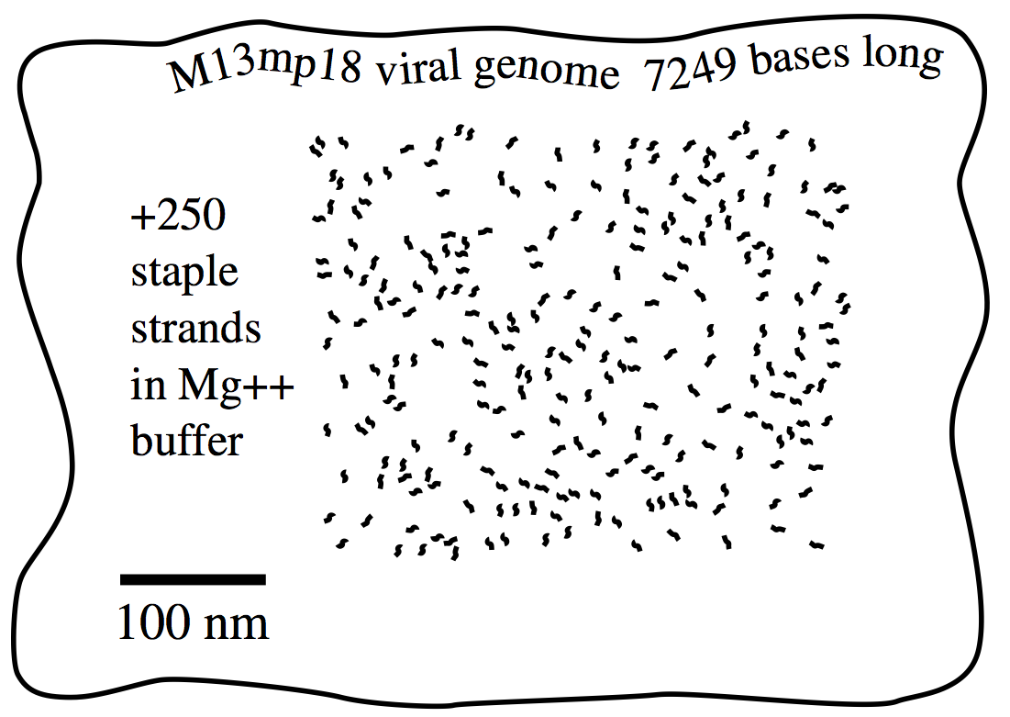
Information in scaffolded DNA origami
TAAGAAGCCCTAGGCAT
GCATTCTTA
ATGCCTAGG
Rothemund, Nature 2006
Notes:
12
How does it work? Again, emphasizing the computer-science-meets-biology theme, it’s all about information. A given location on the scaffold strand is uniquely identified by its sequence content. So if two locations on the scaffold must be near each other in the desired fold, you can synthesize a “staple” strand that has a domain complementary to each location.

Slide 13
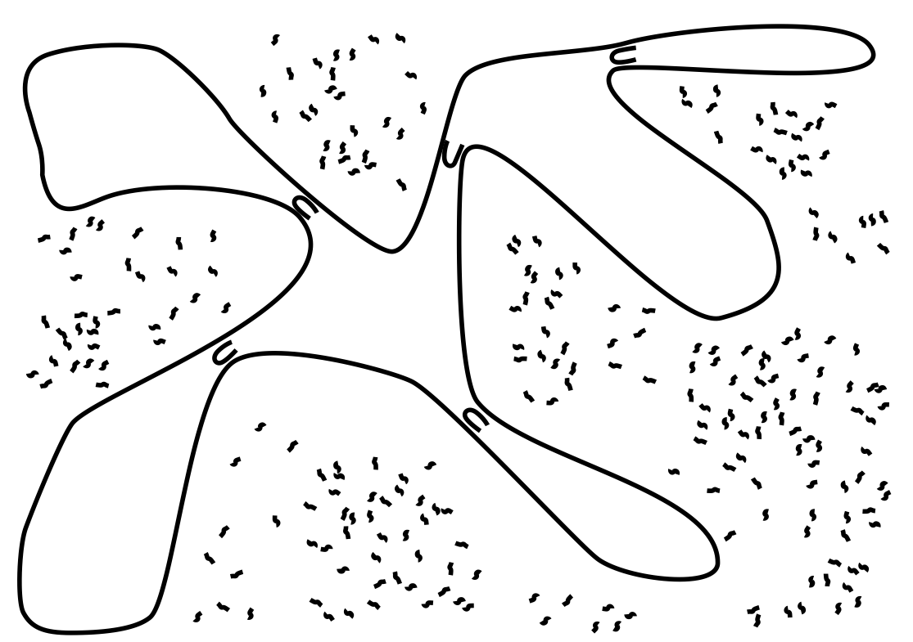
Information in scaffolded DNA origami
Rothemund, Nature 2006
Notes:
13
As self-assembly proceeds, the staple strands will hold together the appropriate parts of the scaffold.

Slide 14
Information in scaffolded DNA origami
The sequence of DNA provides unique addresses for each location.
“Staple strands” bind locations together according to the design.
Rothemund, Nature 2006
Notes:
And eventually the target structure will form – if all goes well.

Slide 15
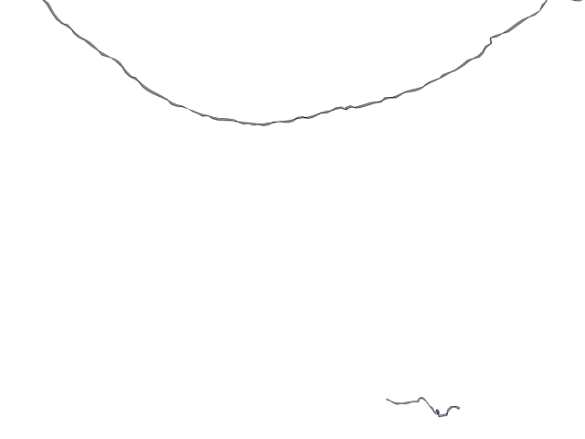
animation by Shawn Douglas
Notes:
Here’s a mind’s eye view of the self-assembly process, in action. Of course, this is oversimplified – but amazingly enough, even after 10 years we still don’t really know how DNA origami folds… we just know that it does. There have been some major advances in our understanding, however, which you will learn about later in the symposium.

Slide 16
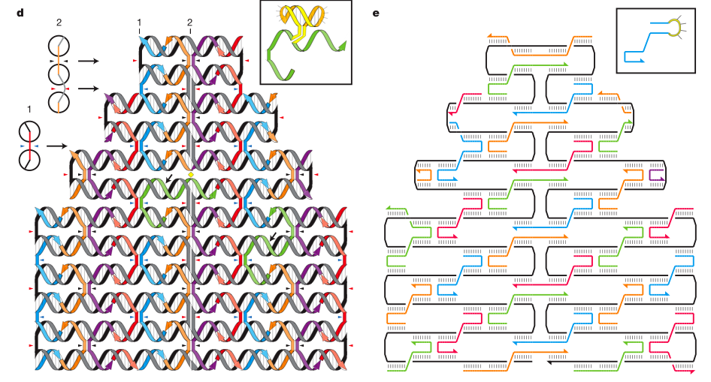
Scaffolded DNA origami

Slide 17
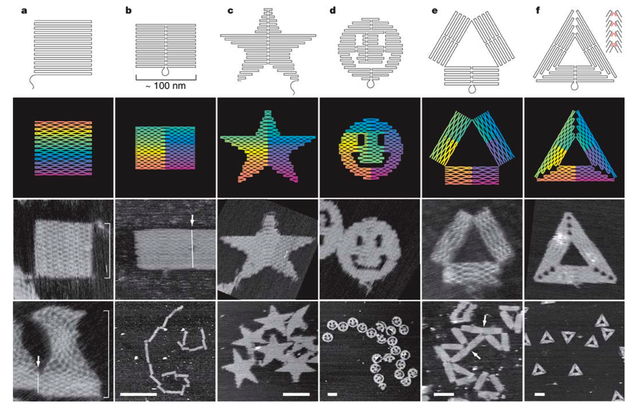
Scaffolded DNA origami
Notes:
Paul’s initial images of DNA origami really got people’s attention. I think everyone loved the… topological disk with three holes. In the lab, after estimating that each reaction produced somewhere around 100 billion origamis in a tiny PCR tube, we joked that it was probably the most concentrated happiness potion ever concocted.

Slide 18
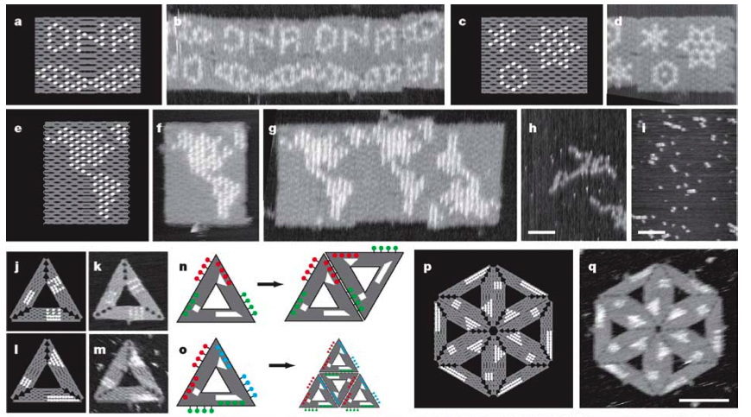
Scaffolded DNA origami
Notes:
We also had a joke about his DNA origami map of the Americas. We figured that in this one experiment, Paul might have made more maps than had ever been made before in the history of human civilization. Not better quality, just more. It’s not implausible, if you figure that on average each of the 50 billion people who have lived since Greek times have owned about 2 maps each. I don’t know.
Anyway, speaking of maps, it’s interesting to see how the scaffolded DNA origami technique has spread around the world.

Slide 19
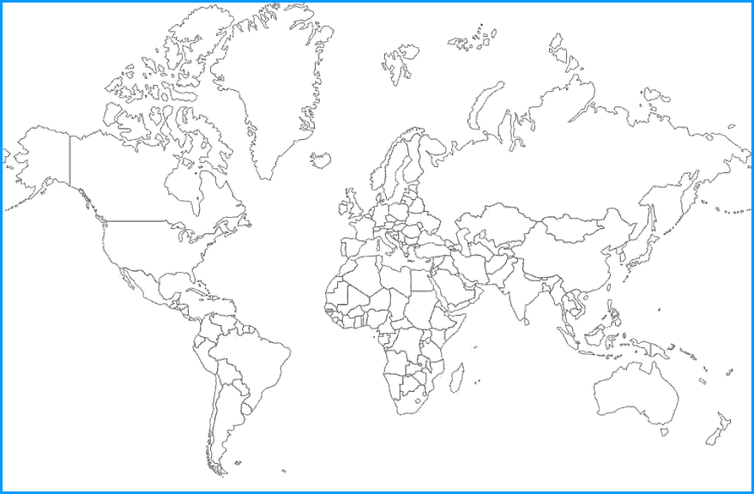
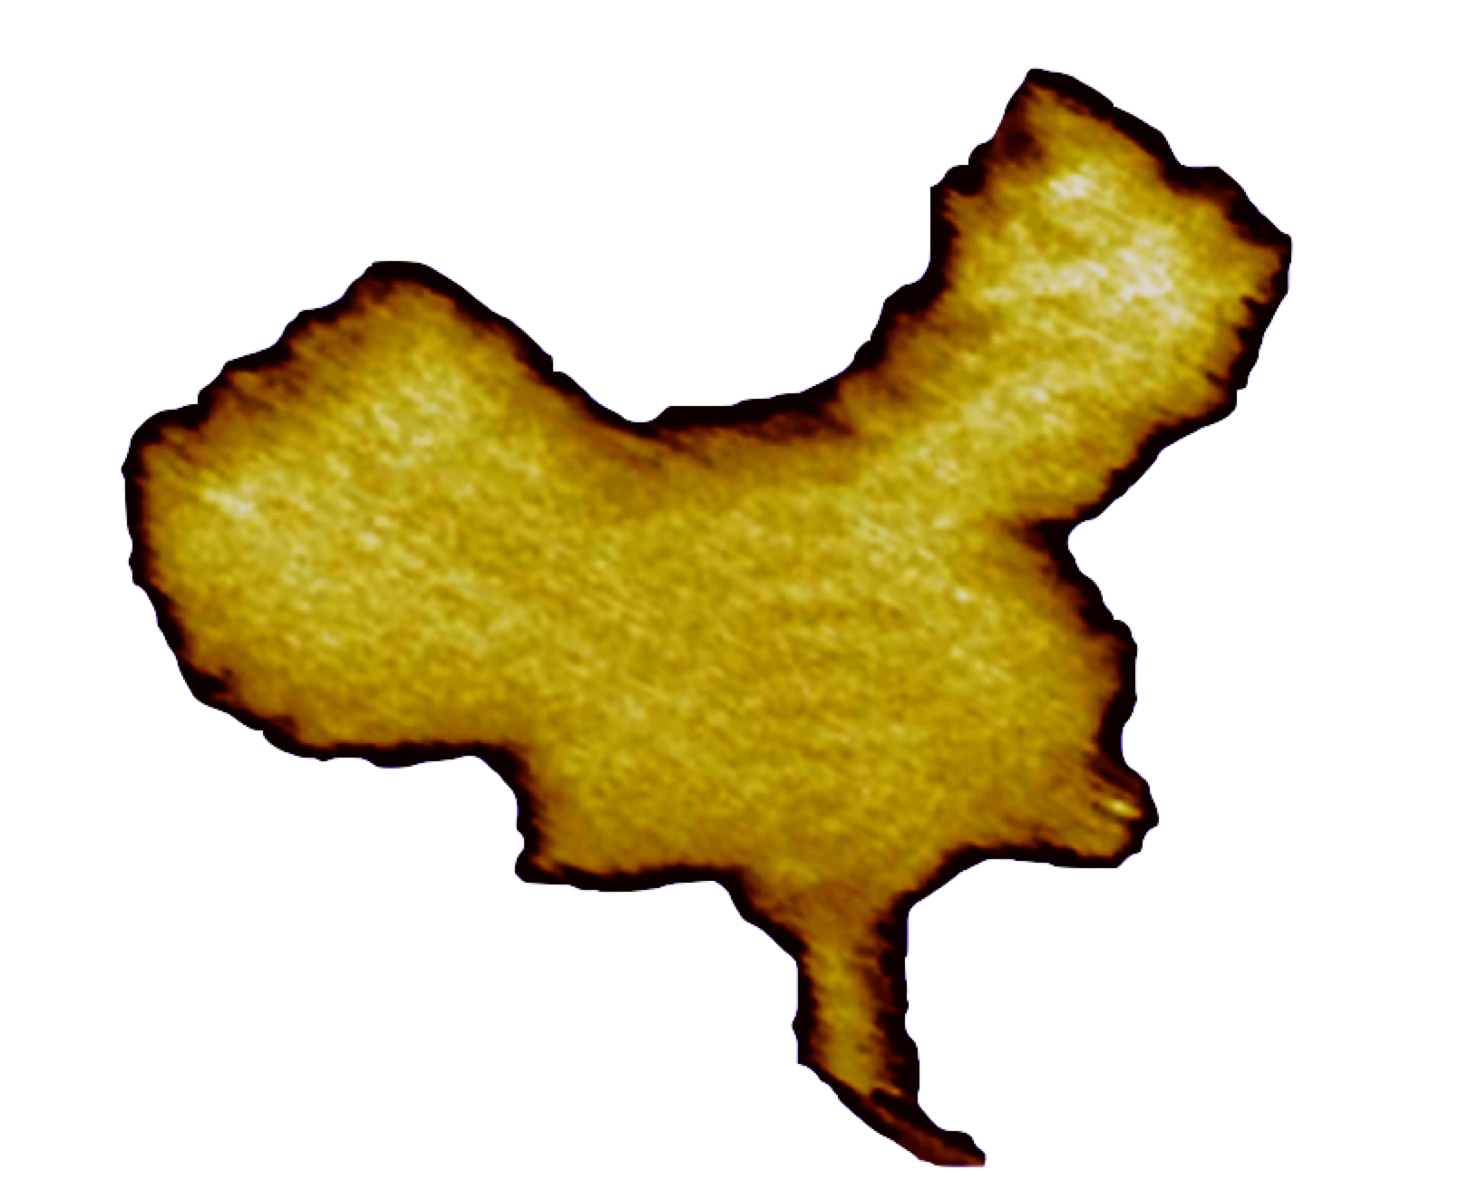
DNA origami all over the world
Rothemund, 2006
Qian et al, 2006
Notes:
[Los Angeles, Shanghai China]
I think it’s appropriate to use a DNA origami map for this part of my talk. There’s Los Angeles. The first independent implementation of DNA origami was in Shanghai, by a graduate student who, after giving up on Paul to release his code, wrote her own software to design an origami in the shape of China. She’s now my wife, so I guess I have yet more things to thank Paul for.

Slide 20
DNA origami all over the world
2007
Rothemund, 2006
Qian et al, 2006
Notes:
[+ Tempe AZ, Boston MA, Sundsvall Sweden, Freiburg Germany]
DNA origami soon spread to other places in America and in Europe. Unfortunately, they didn’t make maps.

Slide 21
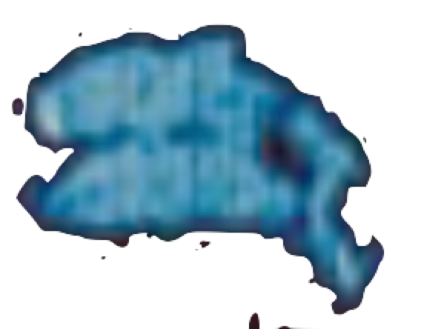
DNA origami all over the world
2008
Rothemund, 2006
Qian et al, 2006
Notes:
[+ Aarhus Denmark, Helsinki Finland, Boise ID]
But once origami made it to Denmark, they at least made dolphins.

Slide 22
DNA origami all over the world
2009
Rothemund, 2006
Qian et al, 2006
Notes:
[+ Munich Germany, New York NY, Tokyo Japan, Huntington WV, Provo UT, Santa Barbara CA, San Jose CA, Houston TX, College Station TX, Kyoto Japan]
With each passing year, DNA origami could be found in more cities.

Slide 23
DNA origami all over the world
2010
Rothemund, 2006
Qian et al, 2006
Notes:
[+ Berkeley CA, Dortmund Germany, Notre Dame IN, Ann Arbor MI]
That’s what I’m plotting here: one dot per city, based on author affiliations of published papers that actually use DNA origami.

Slide 24
DNA origami all over the world
2011
Rothemund, 2006
Qian et al, 2006
Notes:
[+ Beijing China, Cambridge England, Fribourg Switzerland, Dresden Germany, Trieste Italy, Durham NC, Paris France, Daresbury England, Ulsan Korea, Oxford England, Aalto Finland]
Same size dot, no matter how many researchers or how many paper are associated with the city.

Slide 25
DNA origami all over the world
2012
Rothemund, 2006
Qian et al, 2006
Notes:
[+ Stockholm Sweden, Zhengzhou China, Athens GA, Suzhou China, Daejeon Korea, Braunschweig Germany, Gaithersburg MD, Shandong China, Lanzhou China, Pessac France, Kansai Japan]

Slide 26
DNA origami all over the world
2013
Rothemund, 2006
Qian et al, 2006
Notes:
[+ Madrid Spain, Stuttgart Germany, Urbana IL, West Lafayette IN, Barcelona Spain, Delft Netherlands, Dresden Germany, Potsdam Germany, Berlin Germany, Beer Sheva Israel, Orlando FL, London England, Southampton England, Heidelberg Germany, College Park MD, Tel Aviv Israel]

Slide 27
DNA origami all over the world
2014
Rothemund, 2006
Qian et al, 2006
Notes:
[+ Xian China, Kent OH, Osaka Japan, Saitama Japan, Melbourne Australia, Atlanta GA, Chengdu China, Munster Germany, Wroclaw Poland, Martinsried Germany, Udine Italy, Genova Italy, Orsay France, Paderborn Germany, Buenos Aires Argentina, Richland WA, Pittsburgh PA, Neuherberg Germany]

Slide 28
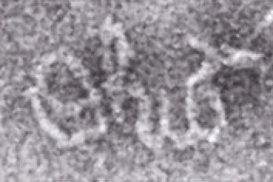
DNA origami all over the world
2015
Rothemund, 2006
Qian et al, 2006
Notes:
[+ Nanjing China, Karlsruhe Germany, Essen Germany, Tallahassee FL, Jyvaskyla Finland, Upton NY, Stony Brook NY, Syracuse NY, Sapporo Japan, Colchester VT, Singapore, Nashville TN, Columbus OH, Basovizza Italy, Jena Germany, Sari Iran, Gorgan Iran, Tampa FL, Stanford CA, York England]
Somewhere over there is Ohio State University.

Slide 29
DNA origami all over the world
2016 1st Q
Rothemund, 2006
Qian et al, 2006
Notes:
[+ Rome Italy, Oak Ridge TN, Baltimore MD, Dublin Ireland, Rolla MO, Krakow Poland, Hong Kong China, Zhenjiang China, Bankok Thailand, Belgrade Serbia, Leoben Austria, Albany NY, Bethesda MD]
[TOTAL: 112 cities. NOTE: Nothing in Brazil, Canada, Africa, India, Russia, Taiwan]
[Figure completed March 4th, 2016. Origami paper has 2883 Google Scholar citations. 430+ per year.]
And here we are. I’d like to say that DNA origami has spread all over the world, but this map shows clearly that certain countries and continents are strikingly more supportive of this kind of science than others. Sobering. But all those blue dots – what are they doing? They are not all making maps and dolphins and logos and other cute things. Hopefully the rest of this symposium will make clear that the power of DNA origami for organizing matter at the nanoscale is remarkably useful, with applications in biology, medicine, chemistry, physics, and more.

Slide 30
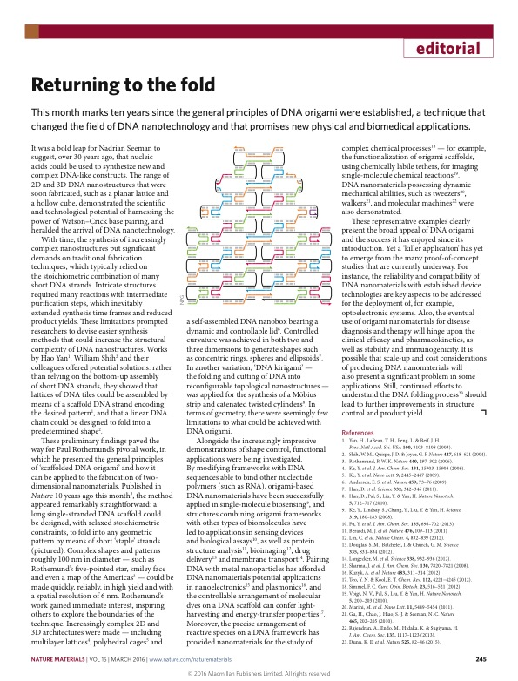
Nature, March 2016
Notes:
This month’s issue of Nature has an editorial on DNA origami – they also noticed the 10 year anniversary of Paul’s paper. They conclude that despite all the “proof of principle” applications, a “killer app” for DNA origami has not yet emerged. Over the next two days, perhaps we’ll get a sense for what the killer app might be… or perhaps not yet. But I am certain that it will be interesting!
It is now time to start the symposium proper. We have an incredible roster of speakers, from all around the world – well, sort of – who have collectively pushed DNA origami and its applications far beyond what I could imagine a decade ago. I’d like to thank them all for taking the time out of their busy schedules to come here to talk with us. Now is a good time also to mention that these talks are being videotaped and we hope to post many or most of them online after the symposium is over, for the benefit of those who couldn’t make it today. Speakers, please remember to briefly repeat questions before you answer them, so that everyone can hear what the question is.
With that, I will turn the microphone over to Paul Rothemund, who will introduce the first speaker and chair the first session.

Slide 31
How to get to lunch

Slide 32
How to get to the banquet

